Slide 1

Pointer and Memory Leak
Sabrina Tarin Chowdhury

Slide 2

Overview of Pointers
A Pointer in C++ is variable whose value is a memory address.
With pointers many memory locations can be referenced.
Some data structures use pointers (e.g. linked list, tree).
The * and & operators
- & operator is the address operator
- * operator is the dereferencing operator. It is used in
pointers declaration

Slide 3
Pointer Declaration
Pointers are declared as follows:
<type> * variable_name ;
e.g.
int * xPtr; // xPtr is a pointer to data of type integer
char * cPtr; //cPtr is a pointer to data of type character
void * yPtr; // yPtr is a generic pointer,
// represents any type

Slide 4
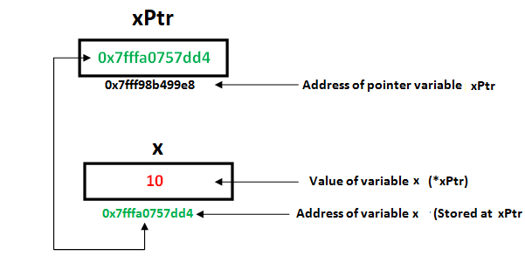
Pointer Assignment
Assignment can be applied on pointers of the same type
If not the same type, a cast operator must be used
Exception: pointer to void does not need casting to convert a pointer to void type
void pointers cannot be dereferenced
Example
int *xPtr, *yPtr;
int x = 5;
…
xPtr = & x; // xPtr now points to address of x
yPtr = xPtr; // now yPtr and xPtr point to x

Slide 5
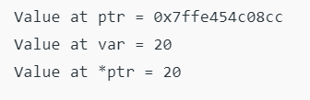
Pointer Simple Demonstration
// C++ program to illustrate Pointers
#include <bits/stdc++.h>
using namespace std;
void geeks()
{
int var = 20;
// declare pointer variable
int* ptr;
// note that data type of ptr and var must be same
ptr = &var;
// assign the address of a variable to a pointer
cout << "Value at ptr = " << ptr << "\n";
cout << "Value at var = " << var << "\n";
cout << "Value at *ptr = " << *ptr << "\n";
}
// Driver program
int main()
{
geeks();
return 0;
}
Output

Slide 6
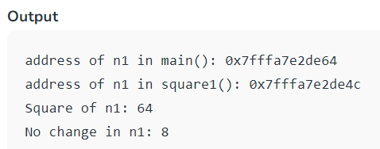
References and Pointers
There are 3 ways to pass C++ arguments to a function:
Call-By-Value
// Pass-by-Value
int square1(int n)
{
// Address of n in square1() is not the same as n1 in
cout << "address of n1 in square1(): " << &n << "\n";
// clone modified inside the function
n *= n;
return n;
}
int main() {
// Call-by-Value
int n1 = 8;
cout << "address of n1 in main(): " << &n1 << "\n";
cout << "Square of n1: " << square1(n1) << "\n";
cout << "No change in n1: " << n1 << "\n"; }

Slide 7
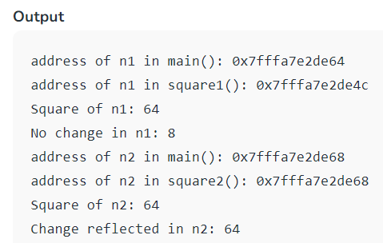
References and Pointers
There are 3 ways to pass C++ arguments to a function:
Call-By-Reference with a Pointer Argument
// Pass-by-Reference with Pointer Arguments
void square2(int* n)
{
// Address of n in square2() is the same as n2 in main()
cout << "address of n2 in square2(): " << n << "\n";
// Explicit de-referencing to get the value pointed-to
*n *= *n;
}
int main() {
// Call-by-Reference with Pointer Arguments
int n2 = 8;
cout << "address of n2 in main(): " << &n2 << "\n";
square2(&n2);
cout << "Square of n2: " << n2 << "\n";
cout << "Change reflected in n2: " << n2 << "\n"; }

Slide 8
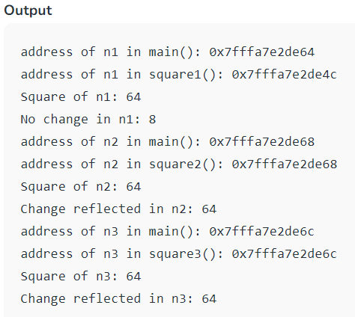
References and Pointers
There are 3 ways to pass C++ arguments to a function:
Call-By-Reference with a Reference Argument
// Pass-by-Reference with Reference Arguments
void square3(int& n)
{
// Address of n in square3() is the same as n3 in main()
cout << "address of n3 in square3(): " << &n << "\n";
// Implicit de-referencing (without '*')
n *= n;
}
int main() {
// Call-by-Reference with Reference Arguments
int n3 = 8;
cout << "address of n3 in main(): " << &n3 << "\n";
square3(n3);
cout << "Square of n3: " << n3 << "\n";
cout << "Change reflected in n3: " << n3 << "\n";
}

Slide 9
Dangling Pointer
A pointer pointing to a memory location that has been deleted (or freed) is called dangling pointer.
// Deallocating a memory pointed by ptr causes
// dangling pointer
#include <cstdlib>
#include <iostream>
int main()
{
int* ptr = (int *)malloc(sizeof(int));
// After below free call, ptr becomes a
// dangling pointer
free(ptr);
// No more dangling pointer
ptr = NULL;
}

Slide 10
Void pointer
Void pointer is a specific pointer type – void * – a pointer that points to some data location in storage, which doesn’t have any specific type.
Void refers to the type. Basically the type of data that it points to is can be any.
If we assign address of char data type to void pointer it will become char Pointer, if int data type then int pointer and so on. Any pointer type is convertible to a void pointer hence it can point to any value.
Important Points
void pointers cannot be dereferenced. It can however be done using typecasting the void pointer
Pointer arithmetic is not possible on pointers of void due to lack of concrete value and thus size.

Slide 11
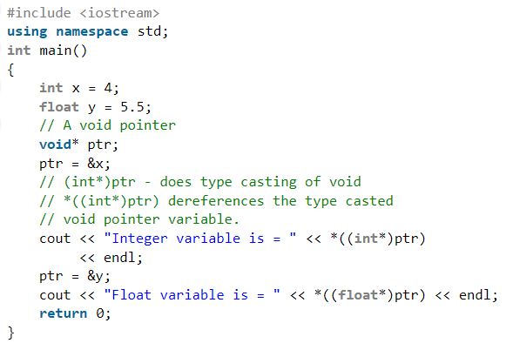
Void pointer

Slide 12
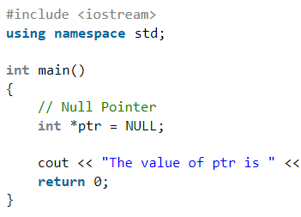

NULL Pointer
NULL Pointer is a pointer which is pointing to nothing. In case, if we don’t have address to be assigned to a pointer, then we can simply use NULL.

Slide 13
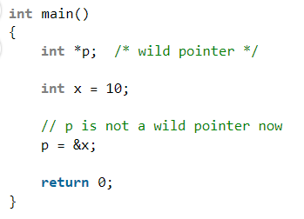
Wild Pointer
A pointer that has not been initialized to anything (not even NULL) is known as wild pointer. The pointer may be initialized to a non-NULL garbage value that may not be a valid address.

Slide 14
Memory leak in C++ and How to avoid it
Memory leakage occurs in C++ when programmers allocates memory by using new keyword and forgets to deallocate the memory by using delete() function or delete[] operator.
One of the most memory leakage occurs in C++ by using wrong delete operator.
The delete operator should be used to free a single allocated memory space, whereas the delete [] operator should be used to free an array of data values.
Disadvantage with memory leakage: If a program has memory leaks, then its memory usage is satirically increasing since all systems have limited amount of memory and memory is costly. Hence it will create problems.

Slide 15
Memory Leak Example
Example 5:
//No variable called x
int* ptr = NULL;
ptr = new int();
*ptr = 5;
cout << ptr; //prints ??
cout << &ptr; //prints ??
cout << *ptr; //prints ??
*ptr = 10;
cout << ptr; //prints ??
cout << &ptr; //prints ??
cout << *ptr; //prints ??
delete ptr; //if I forget??
Memory address: 345
5, then 10
Memory address: 287
ptr
345

Slide 16
Memory Leak Example
Example 6:
//No variable called x
int* ptr = NULL;
ptr = new int();
*ptr = 5;
cout << ptr; //prints ??
cout << &ptr; //prints ??
cout << *ptr; //prints ??
delete ptr; //if I forget??
ptr = new int();
*ptr = 10;
delete ptr;
Memory leak!
Memory address: 345
Memory address: 500
5
10
Memory address: 287
ptr
500

Slide 17
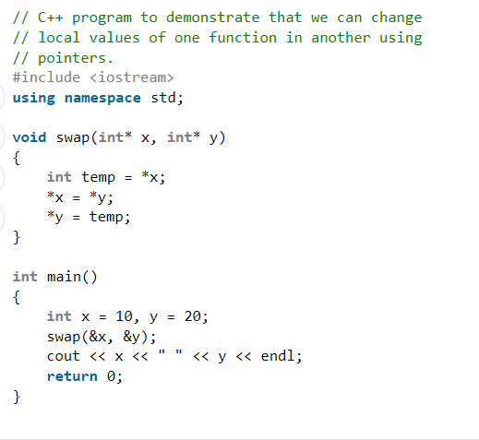
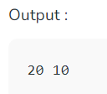
Some Applications of Pointers
To modify variable of function in other. Example to swap two variables

Slide 18
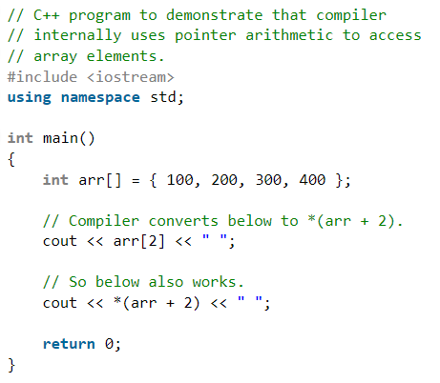
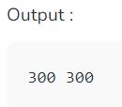
Some Applications of Pointers
For accessing array elements. Compiler internally uses pointers to access array elements.

Slide 19
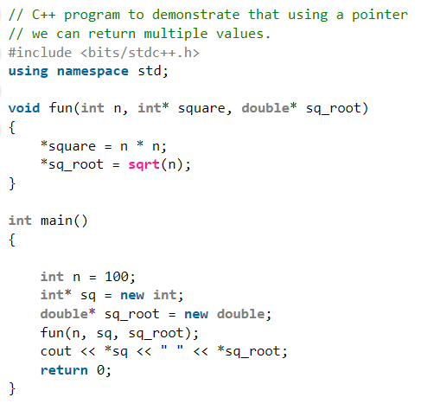
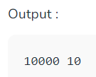
Some Applications of Pointers
To return multiple values. Example returning square and square root of numbers.

Slide 20
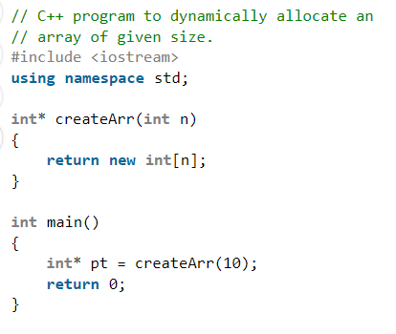
Some Applications of Pointers
Dynamic memory allocation : We can use pointers to dynamically allocate memory. The advantage of dynamically allocated memory is, it is not deleted until we explicitly delete it..

Slide 21
Some Applications of Pointers
To implement data structures. Example linked list, tree, etc. We cannot use C++ references to implement these data structures because references are fixed to a location (For example, we can not traverse a linked list using references)
To do system level programming where memory addresses are useful. For example shared memory used by multiple threads.
In next class we will see how the data structures are implemented by pointers.

